Slide 1
Finding Duplicate Bug Reports
Venkata Sai Meghana Setty

Slide 2
Topics Covered
Idea
Basic CPU
Optimized CPU
Basic GPU
Optimized GPU
Future Plans and Conclusion

Slide 3
Idea

Slide 4
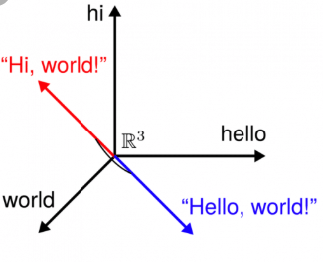
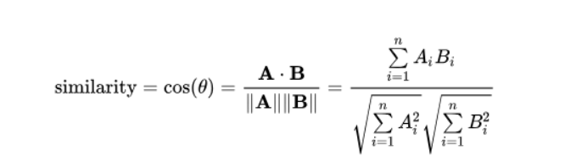
How to find the similarity?
Dataset:
Eclipse dataset (which has around 88k bug reports)
Preprocessing
Considering only the titles for finding similarity.
Removing the stop words
Creating a dictionary of words present in the dataset
Converting the words based on index in the dictionary(why?)
Cosine Similarity

Slide 5
Basic CPU

Slide 6
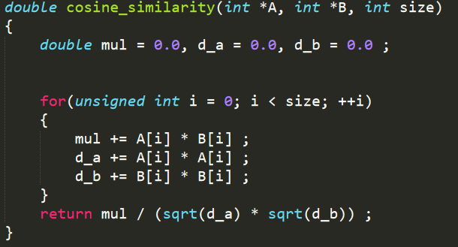
PERFORMANCE
Around: 3447.78 comparsions/sec
Which is : 3447.78*6*57664
= 1.2 Iops/sec
But we expect around : 1280GIops/sec

Slide 7
Optimized CPU

Slide 8
Modifications
Parallelizing the loops using openmp
Using vector operations by using intrinsics
Performing loop unrolling

Slide 9
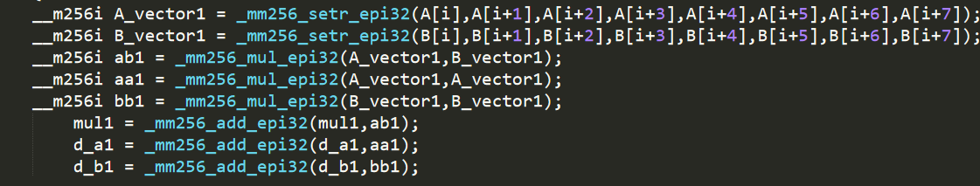
Performance
Around: 2.77*10^6 comparisions/sec
Which is : 2.77*10^6*6*57664
= 9.5 * 10^11
Which is around 74% of the
Expected performance

Slide 10
Basic GPU

Slide 11
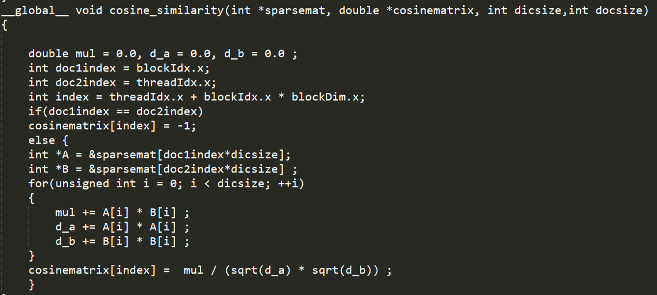
Performance
Around: 44297 comparisions/sec
Which is: 44297*6*57664
= 1.5*10^10 Flops/sec
But we expect around 1.73*10^12 Flops/sec
NOTE: I have not considered PCI-e Transfer in my measurements.

Slide 12
Optimized GPU

Slide 13
Modifications
using multiple streams(8 streams)
Using multiple GPUs(2GPUs)

Slide 14
Performance
Around: 84113 comparisions/sec
Which is 84113*6*57664
= 2.9* 10^10 Flops/sec
There is not much difference in the performane(just twice than basic one). May be because of setting the device quite often.

Slide 15
Future Plans and Conclusion

Slide 16
Plan:
I have to work on Optimizing the GPU code by checking few of the below concepts:
Occupancy
Coalescing
Shared memory
Learnt:
How to use vector instructions
Using streams and multiple GPUs
Basically, how to think about the performance of code when you are programming, and reprogram it.

Slide 17
THANK YOU

